Slide 1

Predicting Interest Rate
Data Understanding
Data Preparation
Modeling
Results
Ekin Pomay Polat
s0581497

Slide 2

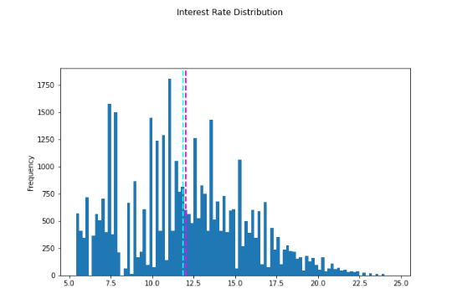
Data Understanding
Initial Data Exploration
39.789 rows and 7 columns
2 categorical features(grade, home_ownership, purpose, term), 5 numerical features(int_rate, loan_amnt, annual_inc)
The target variable is int_rate
Exploring Missing Values and Duplicates
No missing Values, 246 duplicated rows.
Interest rate distribution lies between 5% and 25%
Mostly between 7% and 17%
The common term ➔ '36'.
The most common grade ➔ 'B’.
The most common home ownership ➔ ‘RENT’ ,
‘MORTGAGE’
The most common purpose ➔ ‘DEBT’

Slide 3
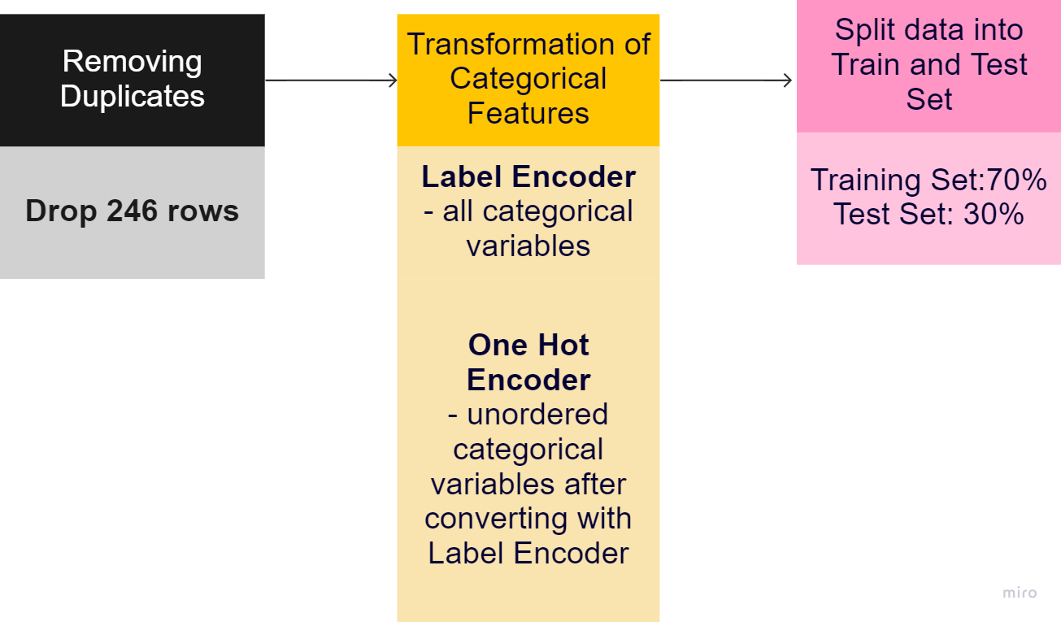
Data Preparation
Preparation road-map

Slide 4
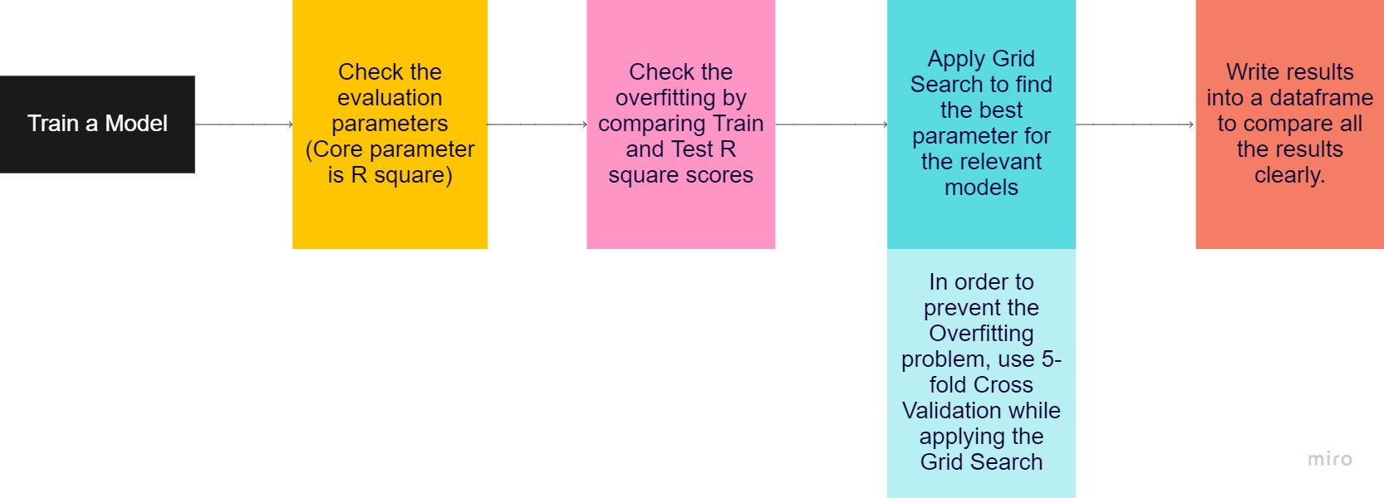
Modeling
Main Goal is predicting interest_rate based on loan amount, loan grade, home ownership status, annual income and purpose for the loan.
Types of models used
Regression Algorithm
  Multiple Linear Regression
  Lasso Regression
  Ridge Regression
Ensemble Algorithm
  Random Forest Regressor
Decision tree Algorithm
  Decision Tree Regressor
Gradient Boosting Algorithm
  Gradient Boosting Regressor
Evaluation metrics
R squared(R2)( the main evaluation metric)
Mean Square Error(MSE)
Root Mean Square Error(RMSE)
Modeling Road-map

Slide 5
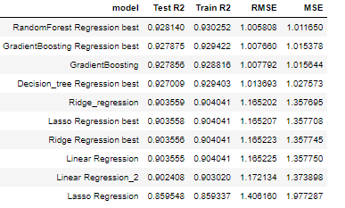
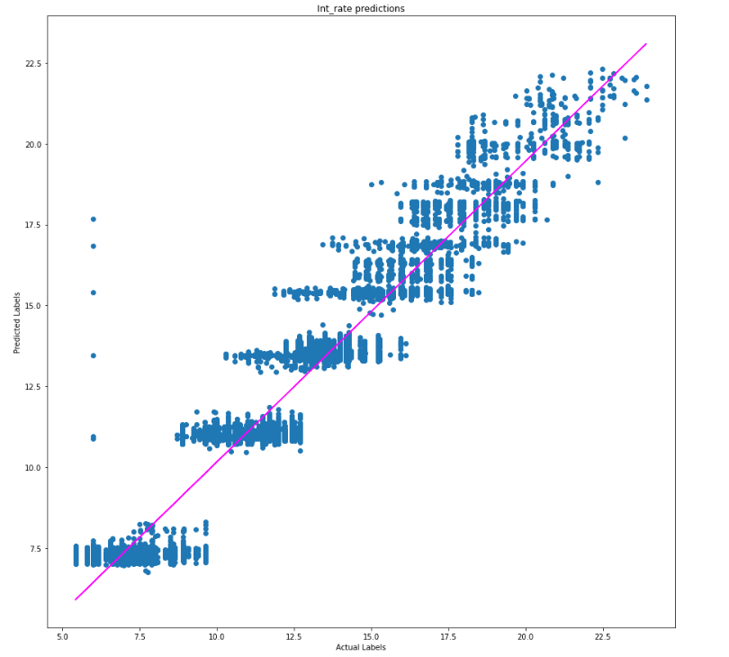
Results
All models gives really good results.
Trying different parameters using GridSearchCV helps us to improve some of the models
RandomForest Regression performs the best out of all trials with R2 score 92.8%.
Best parameters work for the Random Forest Regression model are
learning_rate=0.1
n_estimators=150

